Slide 1

Data Analytics in Cyber Security (CT115-3-M) (Version E)
Data Preprocessing
Module Code & Module Title
Slide Title
SLIDE 1

Slide 2
TOPIC LEARNING OUTCOMES
At the end of this topic, you should be able to:
Understand feature selection techniques
Understand the importance of Exploratory Data Analysis (EDA)
2. Understand data preparation techniques
Module Code & Module Title
Slide Title
SLIDE 2

Slide 3
Machine Learning Pipeline
What do I have What do I need What can I get
Problem Definition
Data collection
“Objective” in “objective function”
Feature extraction
  Flattening, Labeling
Data preparation
  Normalisation by data type
  Dimensionality reduction
Exploratory Data Analysis (EDA)
Algorithm Selection
  Train and Test
Performance Evaluation
  Visualisation
Selection of metrics
May have special data preparation requirements
– Parameter tuning
Model Validation
Repeat Train and Test

Slide 4

Contents & Structure
Feature Selection
Exploratory Data Analysis (EDA)
Data Preparation
Module Code & Module Title
Slide Title
SLIDE 4

Slide 5
Data Preprocessing
Data preprocessing is the first step in any machine learning project – Feature Extraction and Data Preparation.
Data preprocessing can refer to manipulation or dropping of data before it is used to ensure or enhance performance and is an important step in machine learning process.
The phrase "garbage in, garbage out" is particularly applicable to machine learning projects. If we use unclean data for machine learning, the result will not be satisfying enough for our end application

Slide 6
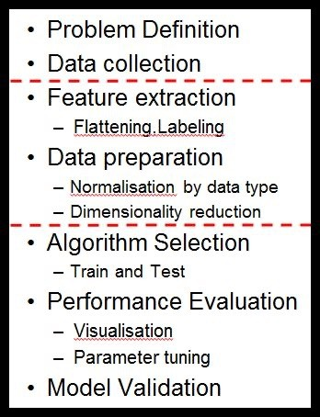
Machine Learning Pipeline
Feature Extraction
Goal: Specifying features useful for prediction
Methods: Check distributions, correlation/covariance checks, drop unique identifiers
Outcome: A “flat” (single table) dataset with selected features.

Slide 7
Exploratory Data Analysis (EDA)
EDA is an important step to first understand the data (identify the trends and patterns within the data, detect outliers or anomalous events, find interesting relations among the variables, points of interest, etc.) before using them for modeling, machine learning, etc.
Checking
Since the dataset will always be large, visualization is essential
Feature Distributions
Class balance
Correlation between input variables and target variable
Correlation between input variables (collinearity)

Slide 8
Feature Selection
The dataset may have many features that may not all be relevant and significant.
  For certain types of data, like genetics or text, the number of features can be very large compared to the number of data points.
  Curse of dimensionality: error increases with the increase in the number of features.
Feature selection is a process of selecting the most relevant variables. The goal is to determine which columns are more predictive of the output.
  Also called “dimensionality reduction” and “feature engineering”.

Slide 9
Feature Value Variance
Columns with low variance provide less information for distinguishing one type of thing from another
  Remove unique identifiers
Columns with high variance have so many unique values that there may be less information for distinguishing one type of thing from another
  ‘bin’ values to reduce the number of unique values

Slide 10
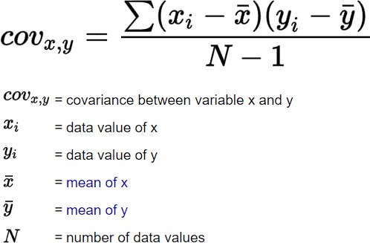
Feature Covariance
In the worst case, one feature can explain (or already determine) all the other features and makes them obsolete.
This results in a high redundancy among the features, increasing computational overhead
The covariance matrix can be used to find redundant features (those that measure the same thing), and make decisions about which can be removed

Slide 11
Pearson Correlation
The Pearson r is a standardized covariance, and ranges from -1, indicating a perfect negative linear relationship, and +1,indicating a perfect positive relationship.
The covariance of two variables divided by the product of their standard deviations gives Pearson's correlation coefficient.
ρ (X,Y) = cov (X,Y) / σX.σY.
A value of zero suggests no linear association, but does not mean two variables are independent, an extremely important point to remember.
Pearson r is not viable for understanding a great many dependencies
The alternative is Mutual Information Correlation

Slide 12
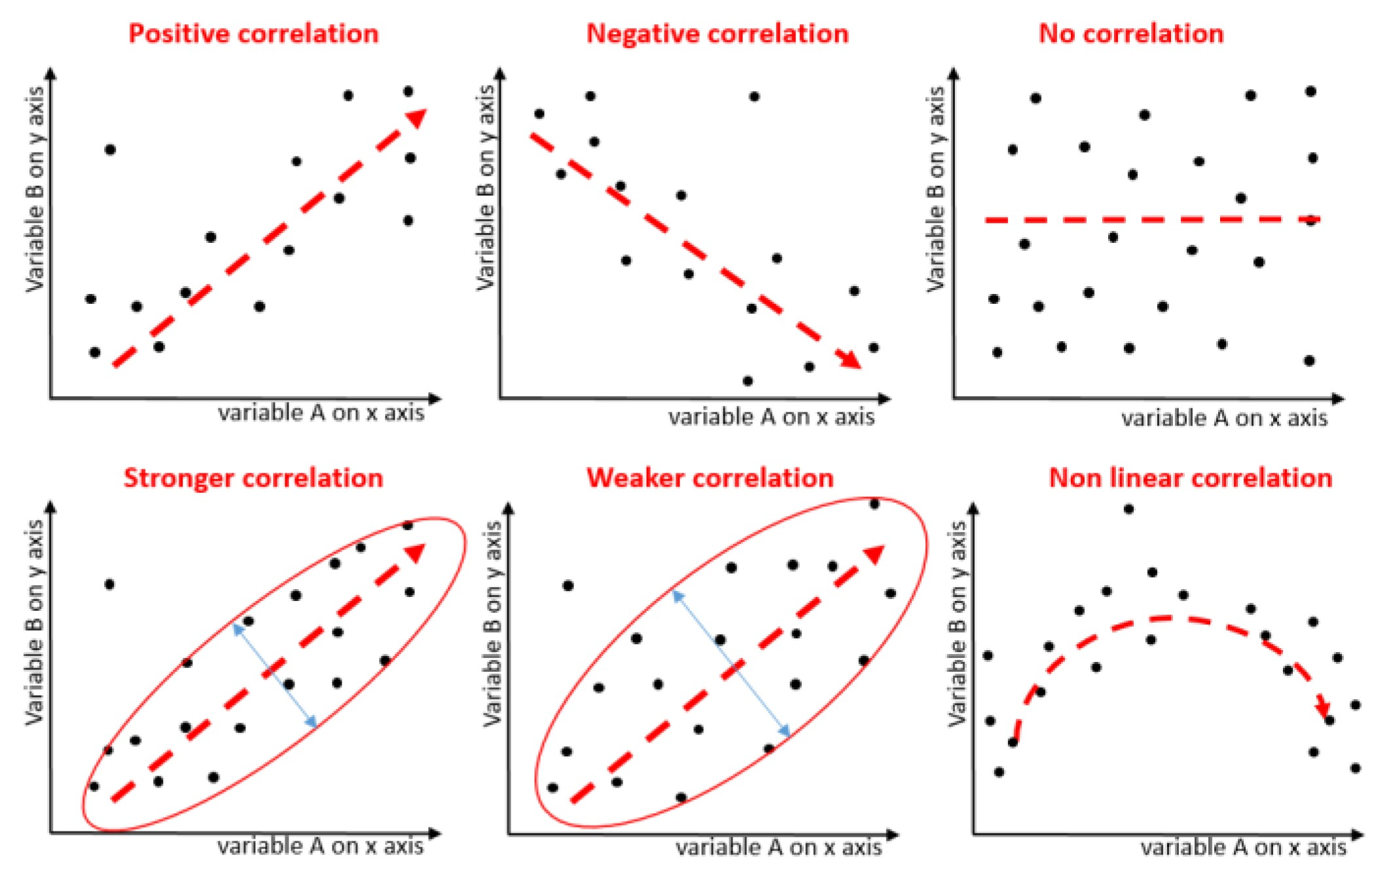
Correlation

Slide 13
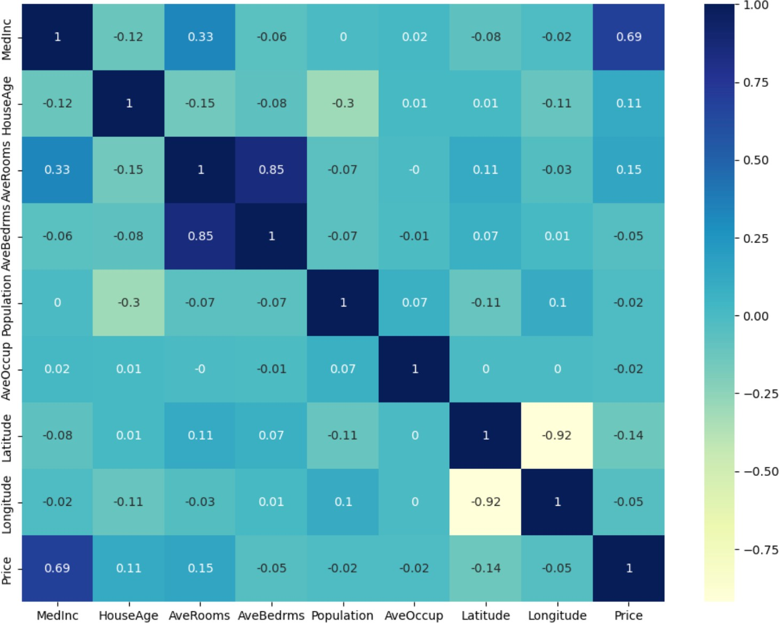
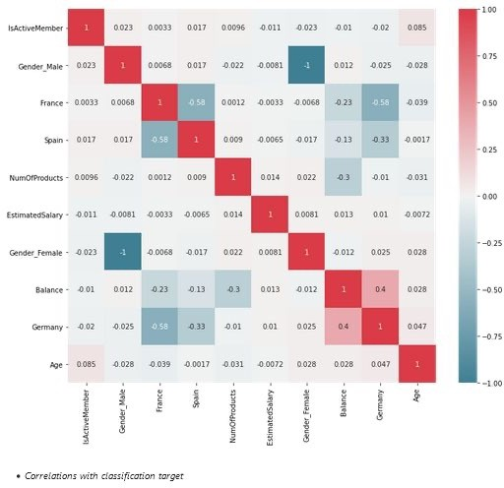
Correlation Matrix “heatmap”
High Correlations:
Check for greater than
0.7 and less
than -0.7

Slide 14
Mutual Information (MI) Correlation
Mutual Information is based on a measure of Entropy
Entropy is defined as a measure of randomness or disorder of a system
For example, if all devices connected to the network are iPhones, then device type random variable has no uncertainty (zero entropy).
However, when Android, Chromebook and iPhone devices are all connected to the network, device type entropy is non-zero, which captures the uncertainty in predicting what device types are connected to the network.
Good Explanation with graphic
https://thenewstack.io/mutual-information-pearson-correlation-building-blocks-ai/

Slide 15
Mutual Information (MI) Correlation
Mutual Information Correlation is based on a measure of Entropy
  The Pearson correlation coefficient assumes normality and linearity of two random variables; Mutual Information removes these assumptions.
In essence, mutual information tells us how useful the feature X is at predicting the random variable Y on a scale of zero to one, with higher numbers indicating better predictors.
  Mutual Information Correlation captures many different types of relationships (not just linear) and is considered the best metric.
However, it doesn’t tell us if the feature is a predictor of success or failure.
Mutual Information and Pearson measures are complementary – they do not always move the same way.

Slide 16
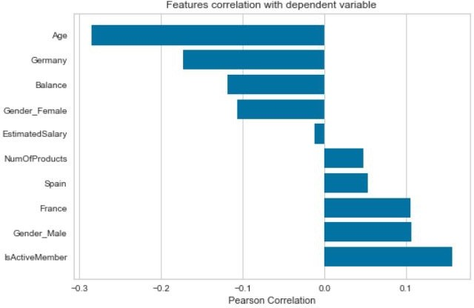
Correlation with Target label

Slide 17
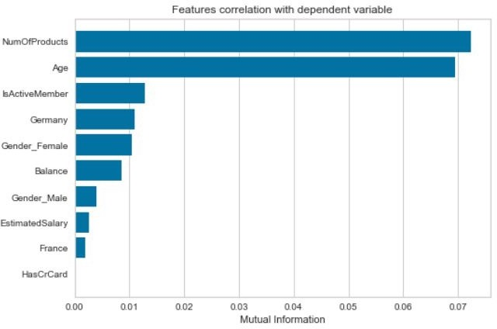
Correlation with Target label

Slide 18
Further Reading
Exploratory Data Analysis https://youtu.be/QiqZliDXCCg
Exploratory Data Analysis with Pandas Python 2023 https://youtu.be/xi0vhXFPegw

Slide 19
Machine Learning Pipeline
Data preparation
Goal: Clean up (normalize, regularize) the data values
Methods: Scaling, dummy variables, interpolating missing values
Outcome: Normalized data in numeric form appropriate for modeling

Slide 20
ML Process: Data Preparation
Needed for several reasons
  Some Models have strict data requirements
    Scale of the data, data point intervals, etc.
  Some characteristics of the data may have a dramatic impact on the model performance
Time required for data preparation should not be underestimated
Dealing with missing values
Transforming text variables
Scaling numeric variables

Slide 21
Algorithms and Data
3 Types of Features
Discrete | binary | CPU friendly!
Continuous | numeric | range
Categorical | text | convert to numeric
Text must be converted to a numeric representation
  An arbitrary sequence (categorical)
  A set of discrete “dummy variables”
Scaling continuous values is required by some algorithms
  usually considered a good idea
https://scikit-learn.org/stable/modules/preprocessing.html

Slide 22
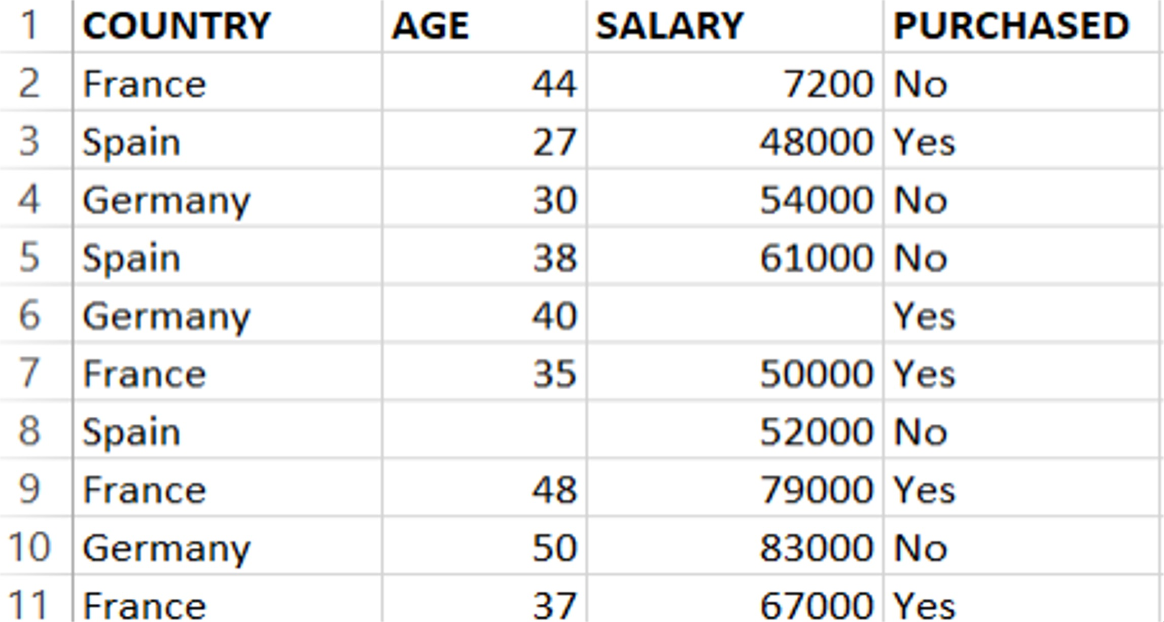
Missing values

Slide 23
Missing values
There may be many reasons for missing values, but only three ways to handle them: deletion, direct estimation, and imputation
Deleting all instances (rows) with missing values would delete a lot of potentially useful information; as basic guideline, any feature (column) with more than 30% missing values should be discarded
Direct estimation requires enough prior knowledge of the dataset to give an accurate estimate for the missing values.
The most frequently used imputation techniques are filling in the mean or median value for the numeric features and filling in the most frequent value for nominal features.

Slide 24
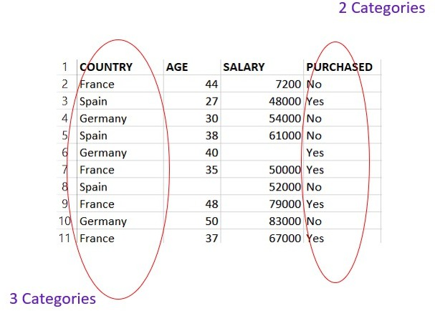
Categorical Data

Slide 25
Encoding Categorical Data
Label Encoding converts a categorical feature into a continuous
feature by assigning a unique integer based on alphabetical order.
  there is a very high probability that the model captures the relationship between countries such as China < India < Russia
One-Hot Encoding creates additional features based on the number of unique values in the categorical feature. Every unique value in the category will be added as a discrete feature.
  One-Hot Encoding is the process of creating dummy variables.
  This used to be two separate required steps
    labelEncoder ::> onehotEncoder
  Not anymore, now we just
    pandas.getdummies()

Slide 26
One-Hot
dns | imap | smtp | http
1 | 0 | 0 | 0
0 | 1 | 0 | 0
0 | 0 | 1 | 0
0 | 0 | 0 | 1
One-Hot encoding is recommended
The big advantage is that the individual fields show up in the correlation matrix
The number of columns can be a drawback though
LabelEncoder
Protocol | Protocol_val
dns | 0
http | 1
imap | 2
smtp | 3
LabelEncoder is most often used (and useful!) for converting target labels from text to numeric values
Required by some SciKit functions
Order does not matter – target labels are only used for matching

Slide 27
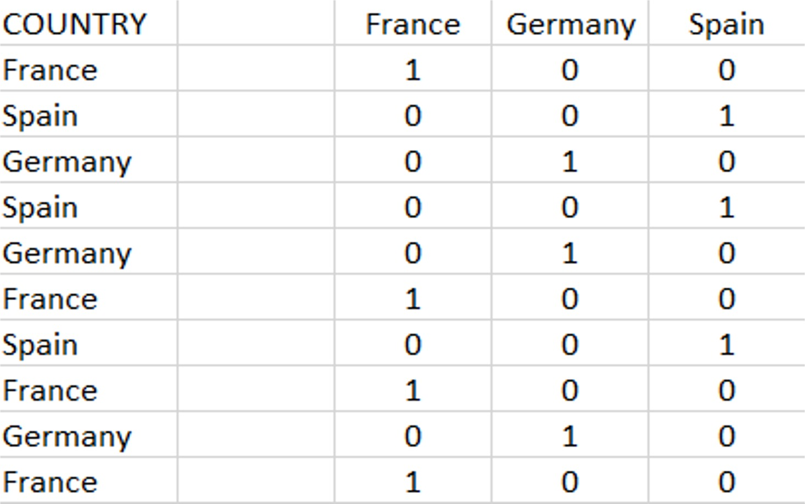
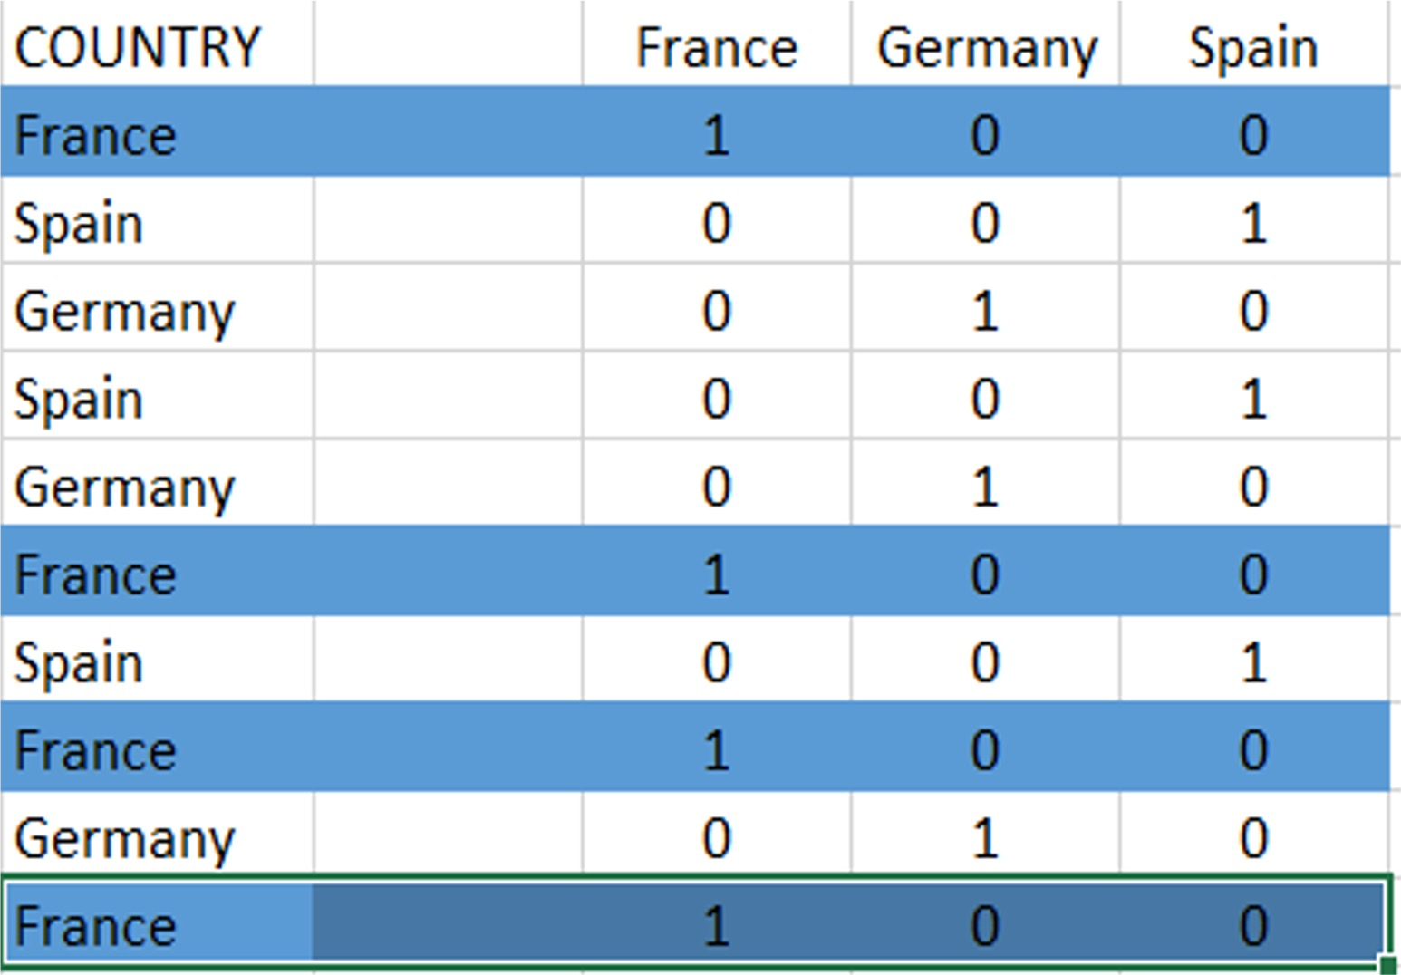
One-Hot Encoding

Slide 28
Encoding Categorical Data
“dummy variables”: In each row, all of the data values are zero except for a single column, following the programming convention “non-zero is True”.
Adding a column for each unique data value means the size of the dataframe grows quickly, requiring more memory and CPU for the analysis.
– This is known as “the curse of dimensionality”
Another consideration with a colourful name is “the dummy variable trap”, formally known as “multicollinearity”,

Slide 29
Encoding Categorical Data
Multicollinearity means the value of one variable can easily be predicted from the values of other variables, which is a serious issue for some linear forecasting models
With linear regression, or generalized linear models estimated by maximum likelihood (ordinary least squares) and no regularization (e.g., ridge, lasso) you need to leave out one column.
  Often, people will set aside the category which is most populated or one which acts as a natural reference point for the other categories.
  Excellent explanation:
https://towardsdatascience.com/drop-first-can-hurt-your-ols-regression- models-interpretability-4ca529cfb707
In every other case, keep all of the new columns

Slide 30
Scaling Continuous Data
Reduce values to a predefined range
Limit absolute magnitude, Preserve relative magnitude
Require data to be scaled:
algorithms like linear regression, logistic regression, neural network, etc. that use gradient descent as an optimization technique
algorithms like KNN, K-means, and SVM that exploit distances between data points to determine their similarity
These work better when the values of every feature have a similar range and are close to normally distributed.
Graphical-model based classifiers (e.g.,Fisher LDA, Naive Bayes), Decision trees and Tree-based ensemble methods (RF, XGB) are invariant to feature scaling
When scaling is not strictly required, it usually does not cause complications.

Slide 31
Scaling Continuous Data
Scalers are linear (or more precisely affine) transformers and differ from each other in the way they estimate the parameters used to shift and scale each feature.
StandardScaler standardizes a feature by subtracting the mean and then dividing all the values by the standard deviation. The result is a distribution with mean=0 and standard deviation=1
MinMaxScaler finds the original minimum and maximum values, then subtracts the minimum and divides by the range for each value. The original distribution is preserved with all values between 0 and 1
There are several others available, suitable for special purposes https://scikit-learn.org/stable/modules/preprocessing.html

Slide 32
100%
DATA
Data Splitting for ML
TRAINING SET
70% / 80%
TEST SET
30% / 20%

Slide 33
Scaling Continuous Data
One important special consideration for supervised learning
If scaling is applied before the dataset is split into train and test sets, information about the distribution of feature values in the test set “leaks” into the train set, which may make the predictions artificially accurate.
So, the rule is: fit only on the train set, then transform the values in both the test and train sets

Slide 34
ML Process: Data Preparation
scaling and redundant data are an algorithm problem, because each algorithm has a different sensitivity to these characteristics of the distribution.
That means scaler.fit() and feature selection are only applied to the training set, and
IF we do scaler.transform() on train we also must scaler.transform() on test for compatibility.

Slide 35

Classifying by Features
Possible features in the shapes:
Color: Blue, Green, Orange, Yellow Size: Large, Small (area)
Geometric shape: Square, Rectangle, Triangle, Circle, … Curvature: Straight sides only, at least one curved side
Number of edges: 1, 2, 3, 4 “Triangleness”: Yes, No Thickness?
Material?
Weight?
Floats on water?

Slide 36
Review Questions
What are some of the feature selection techniques used in machine learning?
What is exploratory data analysis and tasks involved?
What are some of data preparation techniques used in machine learning?
Module Code & Module Title
Slide Title
SLIDE 36

Slide 37
Summary / Recap of Main Points
Feature selection techniques
Importance of exploratory data analysis
Data preparation techniques
Module Code & Module Title
Slide Title
SLIDE 37

